Slide 1
SQL
SQL Languages
DQL
DML
DDL
DCL
DTL
D what the … L

Slide 2
INTRODUCTION - SQL - Structured Query Language
SQL is used for CRUD:
Creating databases
Adding, modifying and deleting database structures
Inserting, deleting, and modifying records in databases
Querying databases (data retrieval)
Create/Update Database Users
SQL functions as a standard relational database language
It can be used (with minor dialectical variations) with the majority of relational DBMS software tools

Slide 3
INTRODUCTION – SQL Command Categories
Data Definition Language (DDL)
Used to create Database Objects.
Data Manipulation Language (DML) - Used to update data in a db.
insert, update, delete, merge
Data Control Language (DCL): used to control access to data stored in a database (Authorization). Examples of DCL commands include:
GRANT , REVOKE
Transaction Control Language (TCL)
These are used to manage the changes made by DML statements as Trasnactions.
It also allows statements to be grouped together into logical transactions.
commit; rollback to savepoint-name; savepoint savepoint-name;
Data Query Language (DQL)
SELECT

Slide 4
INTRODUCTION – SQL Command Categories
Data Control Language (DCL):
used to control access to data stored in a database (Authorization). Examples of DCL commands include:
GRANT to allow specified users to perform specified tasks.
REVOKE to cancel previously granted or denied permissions.
Examples:
grant create table to username;
alter user username quota unlimited on system;
grant create any table to username;
grant drop any table to username;

Slide 5
INTRODUCTION – SQL Command Categories
Transaction Control Language (TCL)
used to manage transactions in a db
These are used to manage the changes made by DML statements.
It also allows statements to be grouped together into logical transactions.
commit;
rollback to savepoint-name;
savepoint savepoint-name;

Slide 6
INTRODUCTION - DDL
Data Definition Language (DDL)
Used to create and modify the structure of the database
Example commands:
CREATE
ALTER
DROP
The schema for each relation.
The domain of values associated with each attribute.
Integrity constraints
And also other information such as
The set of indices to be maintained for each relations.
Security and authorization information for each relation.
The physical storage structure of each relation on disk.

Slide 7
INTRODUCTION - DML
Data Manipulation Language (DML)
Used to insert, modify, delete and retrieve data
Example commands:
INSERT INTO
UPDATE
DELETE
SELECT

Slide 8
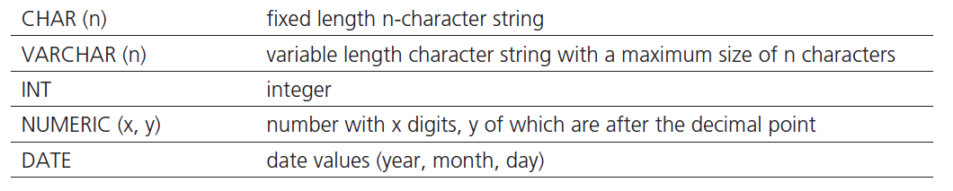
INTRODUCTION
SQL data types
Each column of each SQL created relation has a specified data type
Commonly used SQL data types:

Slide 9
INTRODUCTION - SQL
Brief SQL syntax notes
Semicolon “;” following the end of an SQL statement, indicates the end of the SQL command
SQL keywords, as well as the table and column names used in the SQL commands, are not case sensitive
E.g. SELECT is the same as select or SeLeCt
An SQL statement can be written as one long sentence in one line of text
However, for legibility reasons SQL statements are usually broken down into multiple lines of text

Slide 10
DDL
All DDL commands are auto-committed. That means it saves all the changes permanently in the database.
Command | Description
create | to create new table or database
alter | for alteration
truncate | delete data from table
drop | to drop a table
rename | to rename a table

Slide 11
CREATE TABLE
CREATE TABLE
Used for creating and connecting relational tables
Example:
create table instructor ( ID char(5), name varchar(20) not null, dept_name varchar(20), salary numeric(8,2))
insert into instructor values (‘10211’, ’Smith’, ’Biology’, 66000);
insert into instructor values (‘10211’, null, ’Biology’, 66000);

Slide 12
create table course ( course_id varchar(8) primary key, title varchar(50), dept_name varchar(20), credits numeric(2,0), foreign key (dept_name) references department) );
Primary key declaration can be combined with attribute declaration as shown above

Slide 13
ALTER TABLE
ALTER TABLE
Used to change the structure of the relation, once the relation is already created
Alter Statement 1: ALTER TABLE vendor ADD ( vendorphonenumber CHAR(11));
Alter Statement 2: ALTER TABLE vendor DROP ( vendorphonenumber);

Slide 14
DDL - DROP TABLE
DROP TABLE
Used to remove a table from the database
DROP TABLE Students;
TRUNCATE TABLE
truncate table Student;
Removes all tuples in Student table and reinitialize the table.
Different than DELETE command as delete just removes the tuples.
Truncate does note delete he scheme of the table.

Slide 15
Integrity Constraints in Create Table
not null
primary key (A₁, ..., A_{n} )
foreign key (A_{m}, ..., A_{n} ) references r
Example: Declare dept_name as the primary key for department
.
create table instructor ( ID char(5), name varchar(20) not null, dept_name varchar(20), salary numeric(8,2), primary key (ID), foreign key (dept_name) references department)

Slide 16
Integrity Constraints in Create Table
create table student ( ID varchar(5), name varchar(20) not null, dept_name varchar(20), tot_cred numeric(3,0), primary key (ID), foreign key (dept_name) references department) );
create table department ( ID varchar(5), dept_name varchar(20), building varchar(8), budget numeric(4,2), primary key (ID), );

Slide 17
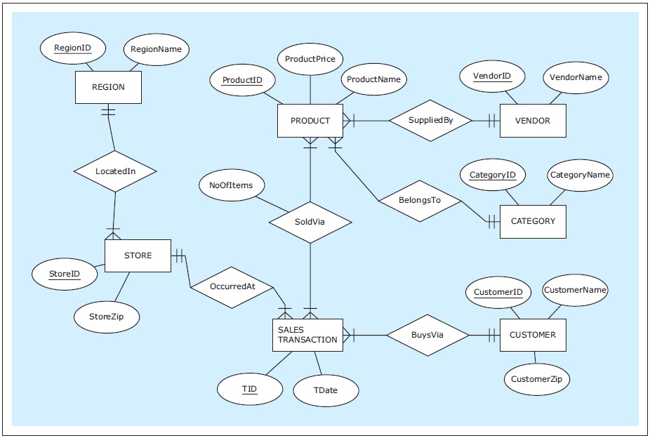
ER diagram : ZAGI Retail Company Sales Department Database
Notes:
This example is discussed on Page 70.

Slide 18
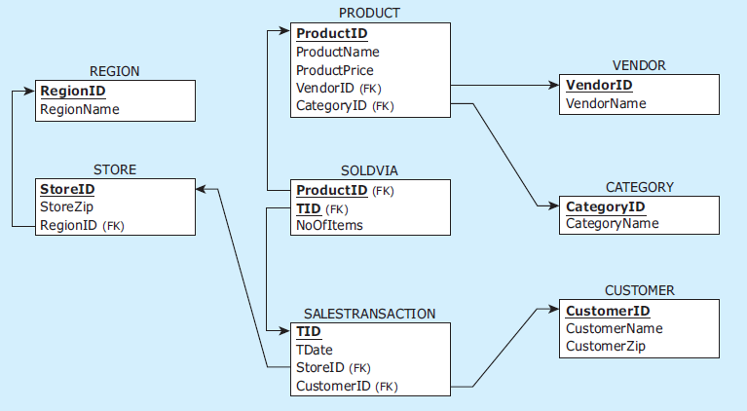
Relational schema: ZAGI Retail Company Sales Department Database
Notes:
This example is discussed on Page 70.

Slide 19
CREATE TABLE statements for ZAGI Retail Company Sales Department Database
CREATE TABLE vendor
( vendorid CHAR(2) NOT NULL,
vendorname VARCHAR(25) NOT NULL,
PRIMARY KEY (vendorid) );
CREATE TABLE category
( categoryid CHAR(2) NOT NULL,
categoryname VARCHAR(25) NOT NULL,
PRIMARY KEY (categoryid) );
CREATE TABLE product
( productid CHAR(3) NOT NULL,
productname VARCHAR(25) NOT NULL,
productprice NUMERIC(7,2) NOT NULL,
vendorid CHAR(2) NOT NULL,
categoryid CHAR(2) NOT NULL,
PRIMARY KEY (productid),
FOREIGN KEY (vendorid) REFERENCES vendor(vendorid),
FOREIGN KEY (categoryid) REFERENCES category(categoryid) );
CREATE TABLE region
( regionid CHAR(1) NOT NULL,
regionname VARCHAR(25) NOT NULL,
PRIMARY KEY (regionid) );
Notes:
This example is discussed on Pages 129-131.

Slide 20
CREATE TABLE statements for ZAGI Retail Company Sales Department Database
CREATE TABLE store
( storeid VARCHAR(3) NOT NULL,
storezip CHAR(5) NOT NULL,
regionid CHAR(1) NOT NULL,
PRIMARY KEY (storeid),
FOREIGN KEY (regionid) REFERENCES region(regionid) );
CREATE TABLE customer
( customerid CHAR(7) NOT NULL,
customername VARCHAR(15) NOT NULL,
customerzip CHAR(5) NOT NULL,
PRIMARY KEY (customerid) );
CREATE TABLE salestransaction
( tid VARCHAR(8) NOT NULL,
customerid CHAR(7) NOT NULL,
storeid VARCHAR(3) NOT NULL,
tdate DATE NOT NULL,
PRIMARY KEY (tid),
FOREIGN KEY (customerid) REFERENCES customer(customerid),
FOREIGN KEY (storeid) REFERENCES store(storeid) );
CREATE TABLE soldvia
( productid CHAR(3) NOT NULL,
tid VARCHAR(8) NOT NULL,
noofitems INT NOT NULL,
PRIMARY KEY (productid, tid),
FOREIGN KEY (productid) REFERENCES product(productid),
FOREIGN KEY (tid) REFERENCES salestransaction(tid) );
Notes:
This example is discussed on Pages 129-131.

Slide 21
DROP TABLE statements for ZAGI Retail Company Sales Department Database
INVALID SEQUENCE
DROP TABLE region;
DROP TABLE store;
DROP TABLE salestransaction;
DROP TABLE product;
DROP TABLE vendor;
DROP TABLE category;
DROP TABLE customer;
DROP TABLE soldvia;
VALID SEQUENCE
DROP TABLE soldvia;
DROP TABLE salestransaction;
DROP TABLE store;
DROP TABLE product;
DROP TABLE vendor;
DROP TABLE region;
DROP TABLE category;
DROP TABLE customer;
Notes:
This example is discussed on Pages 131-132.

Slide 22
INSERT INTO
INSERT INTO
Used to populate the created relations with data
OMAR ONLY - GOTO MYSQL AND SHOW DATABASE COMMANDS

Slide 23
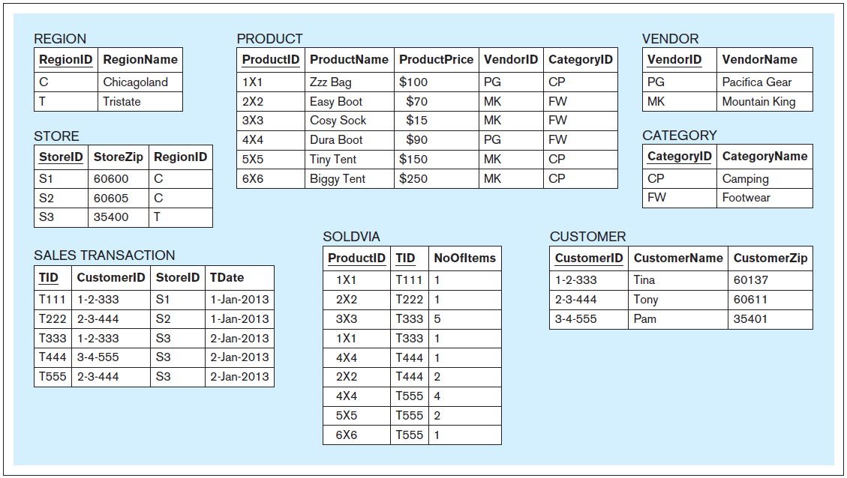
Data records: ZAGI Retail Company Sales Department Database
Notes:
This example is discussed on Page 70.

Slide 24
INSERT INTO statements for ZAGI Retail Company Sales Department Database
INSERT INTO vendor VALUES ('PG','Pacifica Gear');
INSERT INTO vendor VALUES ('MK','Mountain King');
INSERT INTO category VALUES ('CP','Camping');
INSERT INTO category VALUES ('FW','Footwear');
INSERT INTO product VALUES ('1X1','Zzz Bag',100,'PG','CP');
INSERT INTO product VALUES ('2X2','Easy Boot',70,'MK','FW');
INSERT INTO product VALUES ('3X3','Cosy Sock',15,'MK','FW');
INSERT INTO product VALUES ('4X4','Dura Boot',90,'PG','FW');
INSERT INTO product VALUES ('5X5','Tiny Tent',150,'MK','CP');
INSERT INTO product VALUES ('6X6','Biggy Tent',250,'MK','CP');
INSERT INTO region VALUES ('C','Chicagoland');
INSERT INTO region VALUES ('T','Tristate');
INSERT INTO store VALUES ('S1','60600','C');
INSERT INTO store VALUES ('S2','60605','C');
INSERT INTO store VALUES ('S3','35400','T');
INSERT INTO customer VALUES ('1-2-333','Tina','60137');
INSERT INTO customer VALUES ('2-3-444','Tony','60611');
INSERT INTO customer VALUES ('3-4-555','Pam','35401');
Notes:
This example is discussed on Pages 132-134.

Slide 25
INSERT INTO statements for ZAGI Retail Company Sales Department Database
INSERT INTO salestransaction VALUES ('T111','1-2-333','S1','01/Jan/2013');
INSERT INTO salestransaction VALUES ('T222','2-3-444','S2','01/Jan/2013');
INSERT INTO salestransaction VALUES ('T333','1-2-333','S3','02/Jan/2013');
INSERT INTO salestransaction VALUES ('T444','3-4-555','S3','02/Jan/2013');
INSERT INTO salestransaction VALUES ('T555','2-3-444','S3','02/Jan/2013');
INSERT INTO soldvia VALUES ('1X1','T111',1);
INSERT INTO soldvia VALUES ('2X2','T222',1);
INSERT INTO soldvia VALUES ('3X3','T333',5);
INSERT INTO soldvia VALUES ('1X1','T333',1);
INSERT INTO soldvia VALUES ('4X4','T444',1);
INSERT INTO soldvia VALUES ('2X2','T444',2);
INSERT INTO soldvia VALUES ('4X4','T555',4);
INSERT INTO soldvia VALUES ('5X5','T555',2);
INSERT INTO soldvia VALUES ('6X6','T555',1);
Notes:
This example is discussed on Pages 132-134.

Slide 26
DQL
SELECT
Notes:
This example is discussed on Page 153.

Slide 27
SELECT
SELECT
Used for the retrieval of data from the database relations
Most commonly issued SQL statement
Basic form:
SELECT <columns>
FROM <table>
A typical SQL query has the form: select A₁, A₂, ..., A_{n} from r₁, r₂, ..., r_{m} where P
A_{i} represents an attribute
R_{i} represents a relation
P is a predicate.
The result of an SQL query is a relation.

Slide 28
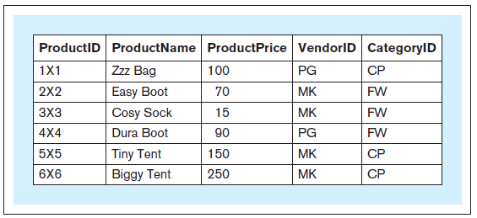
SELECT
Query 1 text: Retrieve the entire contents of the relation PRODUCT
Query 1: SELECT productid, productname, productprice, vendorid, categoryid FROM product;
Query 1 result:
Notes:
This example is discussed on Page 134.

Slide 29
SELECT
Query 1 text: Retrieve the entire contents of the relation PRODUCT
Query 1a: SELECT * FROM product;
Query 1a result:
Notes:
This example is discussed on Page 135.

Slide 30
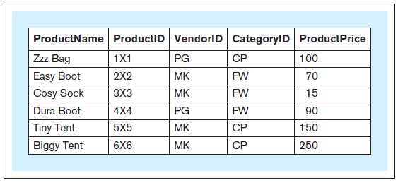
SELECT
Query 2 text: Retrieve the entire contents of the relation PRODUCT and show the columns in the following order: ProductName, ProductID, VendorID, CategoryID, ProductPrice
Query 2: SELECT productname, productid, vendorid, categoryid, productprice FROM product;
Query 2 result:
Notes:
This example is discussed on Page 135.

Slide 31
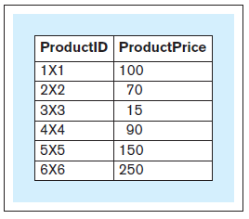
SELECT
Query 3 text: For the relation PRODUCT, show the columns ProductID and ProductPrice
Query 3: SELECT productid, productprice FROM product;
Query 3 result:
Notes:
This example is discussed on Page 135.

Slide 32
SELECT
SELECT
In addition to displaying columns, the SELECT clause can be used to display derived attributes (calculated columns) represented as expressions
SELECT statement can be structured as follows:
SELECT <columns, expressions> FROM <table>

Slide 33
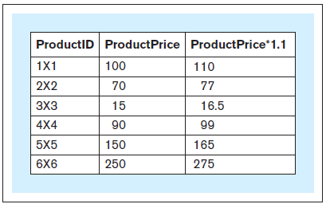
SELECT
Query 3a text: For the relation PRODUCT, show the columns ProductID and ProductPrice and a column showing ProductPrice increased by 10%
Query 3a: SELECT productid, productprice, productprice * 1.1 FROM product;
Query 3a result:
Notes:
This example is discussed on Page 136.

Slide 34
SELECT
SELECT
The SELECT FROM statement can contain other optional keywords, such as WHERE, GROUP BY, HAVING, and ORDER BY, appearing in this order: :
SELECT <columns, expressions>
FROM <tables>
WHERE <row selection condition>
GROUP BY <grouping columns>
HAVING <group selection condition>
ORDER BY <sorting columns, expressions>

Slide 35
WHERE
WHERE
WHERE condition determines which rows should be retrieved and consequently which rows should not be retrieved
The logical condition determining which records to retrieve can use one of the following logical comparison operators:
= Equal to < Less than > Greater than <= Less than or equal to >= Greater than or equal to != Not equal to <> Not equal to (alternative notation)

Slide 36
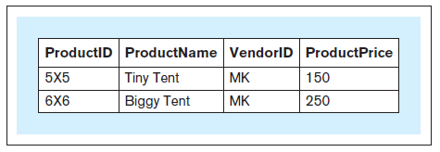
WHERE
Query 4 text: Retrieve the product ID, product name, vendor ID, and product price for each product whose price is above $100
Query 4: SELECT productid, productname, vendorid, productprice FROM product WHERE productprice > 100;
Query 4 result:
Notes:
This example is discussed on Page 136.

Slide 37
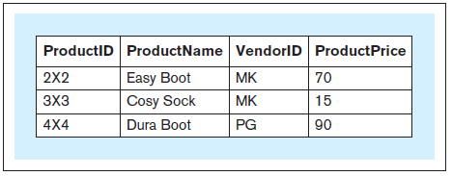
WHERE
Query 5 text: Retrieve the product ID, product name, vendor ID, and product price for each product in the FW category whose price is equal to or below $110
Query 5: SELECT productid, productname, vendorid, productprice FROM product WHERE productprice <= 110 AND categoryid = 'FW';
Query 5 result:
Notes:
This example is discussed on Page 137.

Slide 38
DISTINCT
DISTINCT
Can be used in conjunction with the SELECT statement
Eliminates duplicate values from a query result

Slide 39
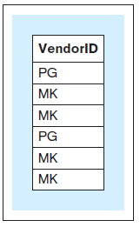
DISTINCT
Query 6 text: Retrieve the VendorID value for each record in the relation PRODUCT
Query 6: SELECT vendorid FROM product;
Query 6 result:
Notes:
This example is discussed on Page 137.

Slide 40
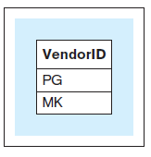
DISTINCT
Query 7 text: Show one instance of all the different VendorID values in the relation PRODUCT Query 7: SELECT DISTINCT vendorid FROM product;
Query 7 result:
Notes:
This example is discussed on Page 137.

Slide 41
ORDER BY
ORDER BY
Used to sort the results of the query by one or more columns (or expressions)

Slide 42
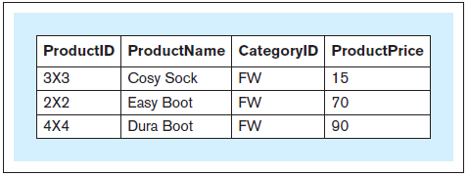
ORDER BY
Query 8 text: Retrieve the product ID, product name, category ID, and product price for each product in the FW product category, sorted by product price Query 8: SELECT productid, productname, categoryid, productprice FROM product WHERE categoryid = 'FW' ORDER BY productprice;
Query 8 result:
Notes:
This example is discussed on Page 138.

Slide 43
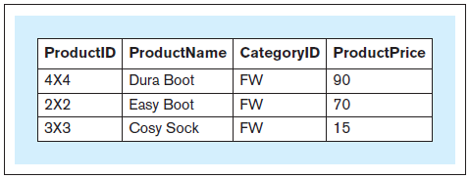
ORDER BY
Query 9 text: Retrieve the product ID, product name, category ID, and product price for each product in the FW product category, sorted by product price in descending order Query 9: SELECT productid, productname, categoryid, productprice FROM product WHERE categoryid = 'FW' ORDER BY productprice DESC;
Query 9 result:
Notes:
This example is discussed on Page 138.

Slide 44
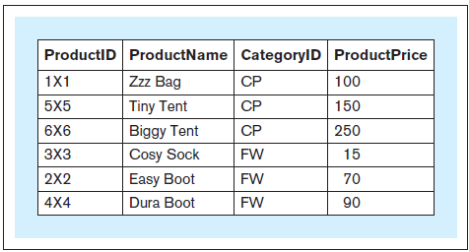
ORDER BY
Query 10 text: Retrieve the product ID, product name, category ID, and product price for each product, sorted by category ID and, within the same category ID, by product price Query 10 : SELECT productid, productname, categoryid, productprice FROM product ORDER BY categoryid, productprice;
Query 10 result:
Notes:
This example is discussed on Page 138.

Slide 45
LIKE
LIKE
Used for retrieval of records whose values partially match a certain criteria

Slide 46
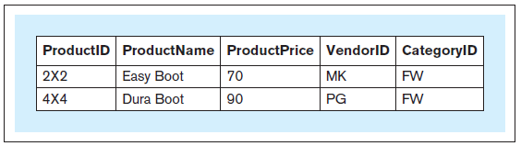
LIKE
Query 11 text: Retrieve the record for each product whose product name contains the phrase ’Boot’
Query 11 : SELECT * FROM product WHERE productname LIKE '%Boot%';
Query 11 result:
Notes:
This example is discussed on Page 139.

